Slide 1
Lunchtime Supervisors Game Pack

Slide 2
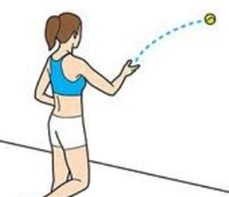
Ball and a Wall
How many times can you throw and catch a tennis ball throwing it against a wall using one hand?
You must be 3m away and standing on one leg!

Slide 3
Shoulder Touch Challenge
How many Shoulder Touch press ups can you complete in 1 minute?

Slide 4
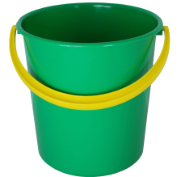
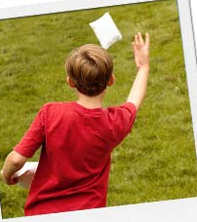
Bean bag bucket challenge
The 5m Bean Bag Challenge!
In one minute how many bean bags can you throw into a bucket in 1 minute?
Good luck!
5m

Slide 5
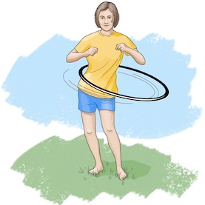
Hula Hoop Challenge
The Hula Hoop test!
It’s very simple. The hula hoop must keep moving all the time and you cannot touch it with your hands once you have begun. How long can you hula for?!

Slide 6
Wacky Races – Assault Course
Split the amount of people that want to play by 2 or 4, and send each team to a corner.
Move whole body through each hoop
Agility cones
(Run in and out)
The River
(Jump over the gap)
Stepping Stones

Slide 7
Zoneball
This is the game where two teams play against each other (make sure they’re wearing bibs so they know who to pass to). The aim of the game is to throw the ball to the catcher who has to stand in the end zone. No one is allowed to walk holding the ball!
END-ZONE
END-ZONE
END-ZONE
END-ZONE
If the children are finding it too easy – Make a smaller end zone, make time limits on how long pupils can hold the ball, Use a smaller ball.
If the children are finding it too hard – Allow bounces of the ball, let the children use a larger ball, Make more space in end-zone

Slide 8
Hoop & Bean bag – Golden ladder
This is a shooting game!
If you score from Level 1, move to Level 2 and so on…..
The winner is whoever gets the top of the ladder first!

Slide 9
Shark Attack!
This is a simple game.
Players run around (not in the hoops) and wait for the leader to shout ‘Shark’
Take away hoops one at a time. Keep playing until we have a winner!

Slide 10
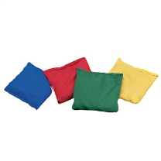
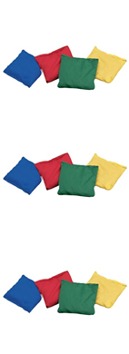
Bank Breakers
Split the group into two teams.
One team has to run into the opposite bank and bring 1 bean bag back at a time.
Players must sprint when on the way to rob the bank, bean bags must be balanced on heads on the way back!

Slide 11
Sumo Tail Tag
Sumo
Tail
Tag
‘Top pitch’
Each player must tuck a bib into the side of their shorts/trousers
Without leaving the circle, one player has to attempt to pull out their opponents bib to win!
If you have enough wishing to play, you can make a mini-league by having a top and bottom pitch. If a player wins they move up the ladder, if they lose they move down!
Sumo
Tail
Tag
Sumo
Tail
Tag
Sumo
Tail
Tag
‘Bottom pitch’

Slide 12
Danger Ball!
For this game split the group into two teams, they can’t cross the line of cones (blue circles). The aim is to throw bean bags at the large ball to make it roll towards the other team.
If the ‘Danger ball’ crosses the Red teams line, the Yellow team win!
If necessary let one child to be the ‘fetcher’ they can run out of the throwing zone and bring bean bags back to their team mate

Slide 13
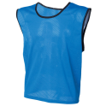
NOUGHTS AND CROSSEs!
Split the group into two teams. ‘Noughts’ = Blue, ‘Crosses’ = Orange.
You must run and place a bib into a hoop, the aim is to get three bibs in a row! Good luck!

Slide 14
D.O.G
Each member of staff stands in the middle of a circle. Throw the ball softly
to a pupil, once caught they throw the ball back. Once pupils are familiar
with exercise decide on a small word (Use something relevant from
classroom – Numeracy, Literacy, Topic) Each time the ball is dropped they
began to spell out the word (If the word is ‘Dog’ then one drop
means they get ‘D’).
Ask M/A to move further back from feeder, if you feel the children
are ready, allow to play the game without the adult in the centre of the circle.

