Slide 1
Team penalty shoot-out!
Before the World Cup day each child will have drawn their country out of a hat.
On the World Cup day (to be decided by the School) each child will take 3 penalties against their teacher. The group with the highest amount of penalties scored out of 12 wins!
Throughout the week each child will be given a World Cup challenge sheet – every child that completes the challenge sheet will get a certificate!

Slide 3
Penalty shoot-out!
Group A ( /12)
Group B ( /12)
Group C ( /12)
Group D ( /12)
Group E ( /12)
Group F ( /12)
Group G ( /12)
Group H ( /12)

Slide 4
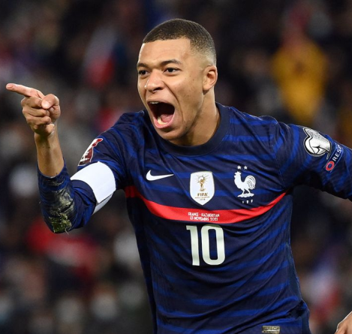
World Cup Challenge Week!
Train like a World Cup superstar!
Colour in each football when you have completed the challenge – Enjoy!
Play a penalty shootout against someone at home
Create your own goal celebration
(you must score in order to do this!)
Complete 50 shoulder touch press ups (doesn’t have to be in one go!)
Play a 1 v 1 mini-match with someone
(First to 10 wins!)
20 keep ups for 5 days in a row! (doesn’t have to be in one go!)
Design your own strip for a country
of your own choice
Practice your passing with both of
your feet
Use a teddy bear/toys or boxes as
a wall and practice your free kicks!

Slide 5
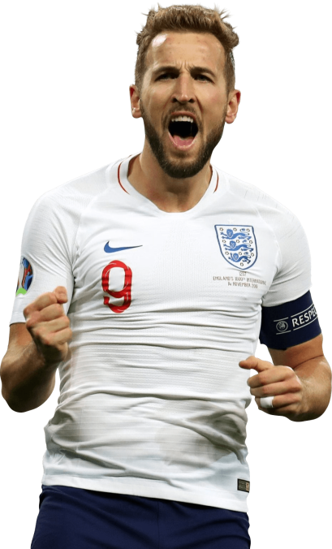
Well
Done!!
This is to certify that
Has completed the World Cup challenges!

